Slide 1

Event Processing Course
Event Types
(relates to chapter 3)

Slide 2
Lecture outline
Meta-data
Event types
Event header
Event payload
Event to event relationships
Events in practice in event processing products
Events in practice in messaging and standards

Slide 3

What is METADATA?
Author: Banathy,B.H.
Year: 1973
Title: Developing a Systems View of Education: The Systems-Model Approach
Publisher: Lear Siegleer, Inc./Fearon Publishers
Description:
A system needs to be adaptive If it fails to deliver expected outcomes: 1. it adjusts 2. expectations adjust 3. it terminates
Call Number: H#X

Slide 4
Who inputs METADATA?
Two Camps:
  Internal referenced - Users input their own metadata
  External referenced – Professionals input metadata
number of electronic objects is growing rapidly
metadata required is too much for third-party indexers

Slide 5
Metadata and RDF/XML
XML = syntax
RDF = structure
Metadata =
semantics & resources

Slide 6
Event Type
An event type is a specification for a set of event
objects that have the same semantic intent and same
structure; every event is considered as an instance of
an event type.

Slide 7
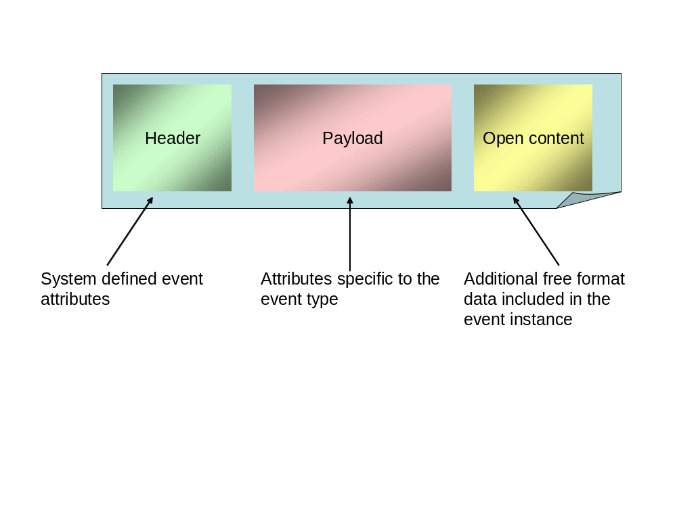
Event type definition

Slide 8
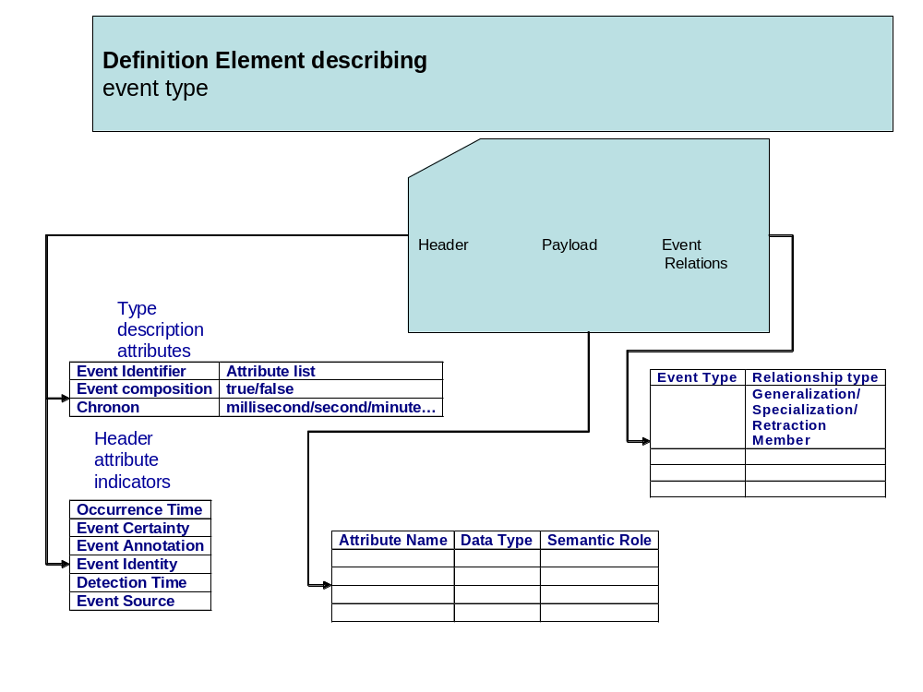
Event Type Building Block

Slide 9
Event type description attributes
The event type identifier attribute identifies the event type definition that describes the event instance
The event composition attribute is a Boolean attribute that denotes whether the specific event instance consists of composition of several events or not.
The temporal granularity (or Chronon) attribute denotes the "atom of time" from a particular application's point of view. It stands for the unit in which time-stamps in the application are being measured.
  examples: second, minute, hour, or day

Slide 10
Header attribute indicators
The occurrence time attribute is a time stamp with a precision given by the event type's temporal granularity (Chronon). It records the time at which the event occurred in the external system.
The event certainty attribute denotes an estimate of the certainty of this particular event.
The event annotation attribute provides a free-text explanation of what happened in this particular event.

Slide 11
Header event instance attributes – cont.
The event identity attribute is a system generated unique id for each individual event instance.
The detection time attribute is a time stamp (in the event type’s temporal granularity) that records the time in which the event became known to the event processing system.
The event source attribute is the name of the entity that originated
this event. This can be either an event producer or an event processing agent.

Slide 12
Payload attributes: data types
Basic simple data types:
  String
  Integer
  Floating point number
  Fixed precision decimal number
  Binary data
  Boolean
More advanced simple data types:
  Time stamp
  Location
  Reference to another event

Slide 13
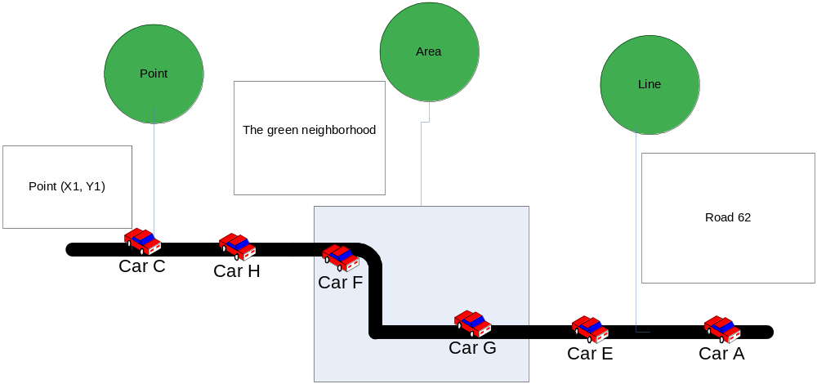
Location data type

Slide 14
Attribute with semantic roles
An event entity reference is an event attribute whose value is a reference to a particular entity external to the event.
A common attribute is an event attribute whose semantics are defined by the attribute name, so within the application domain all attributes with the same name are considered to be semantically equivalent.

Slide 15
Event to event relations
A retraction event relationship is a property of an event type referencing a second event type that is the logical retraction of the referencing event type.
The event generalization and specialization relationships indicate that an event type is a generalization or specialization of another event type, possibly conditioned by a predicate.
An event type is said to be a member of a composite event type if its instances can be included in instances of the composite event type. The membership relationship applies only to composite event types. It indicates that the related event type is a member of the composite event type.

Slide 16
Events Representation in Practice
Flat representation: similar to a normalized tuple in a database.
Structure representation: similar to a record that may include arrays and tuples within the structure.
XML representation: using XML schema to define the structure.
Object: The event is represented as an object; methods have to be applied in order to retrieve its content.

Slide 17
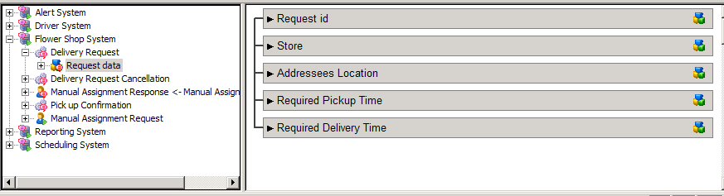
Example 1: Websphere Business Events

Slide 18
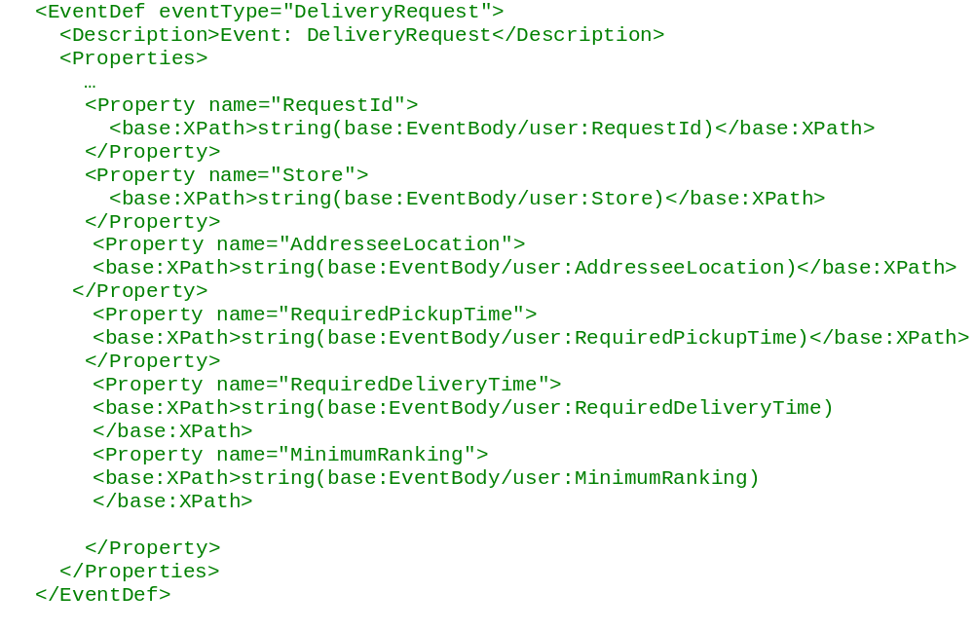
Example 2: ruleCore

Slide 19
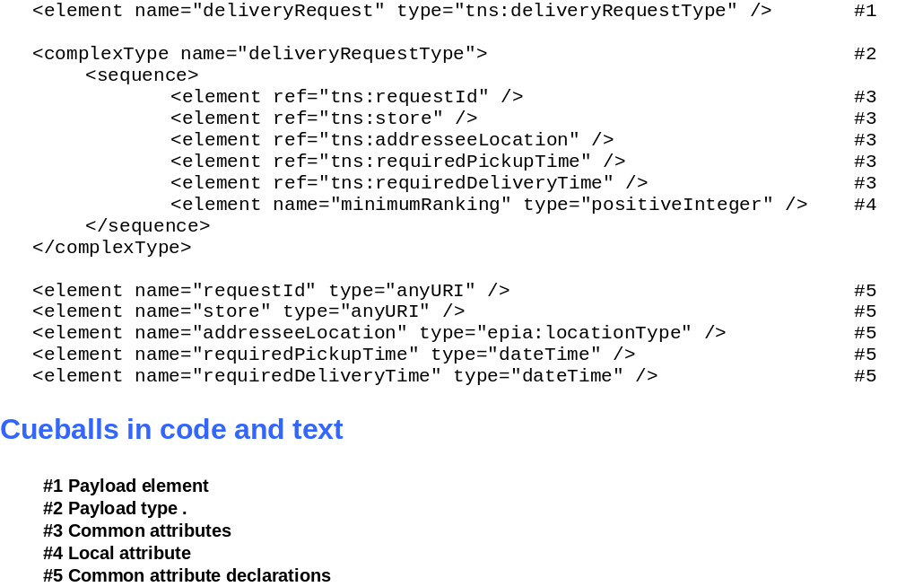
Example 3 – XML

Slide 20
Event Types in standards and various areas
Many systems have some concept of an event for processing/producing/consuming.
Associated with this concept, and explicitly formalized to a greater or lesser extent, are the following:
  Metadata (headers) that accompany event data as it is transmitted
  Physical wire format(s) used to carry the event data and headers as they are transmitted (i.e. the serialization of the event type and headers)
  Metamodel used to express event types (i.e. way of saying what kind of event data you would expect in a particular event type)
  Means of classifying event types
  Programming models that allow processors to manipulate event headers and data

Slide 21
Example: IBM MQ Telemetry Transport
WebSphere MQ Telemetry Transport is a lightweight publish/subscribe protocol flowing over TCP/IP for remote sensors and control devices through low bandwidth communications.
  Metadata that accompanies the event data
    Topic Name (UTF8 string)
    Retain (Last Known Good) Flag – event is suitable as an initial message for a new consumer
  Payload is treated as an opaque BLOB, the application defines the content and serialization
  No Metamodel defined
  Types are classified by topics (by the user)

Slide 22
Example: WebSphere MQ/MB
  Metadata that accompanies the event data
    MQ Message Descriptor
      Includes Timestamp, Format, Priority, Expiry, MsgID, Persistence (reliabiliy), Security/Auditing context
    “Pub/sub” headers
      Topic Name, Retain (and other) flags, Publish Timestamp, Sequence Number
    Application-defined context
  Metadata is serialized in a public but MQ-Proprietary fashion. Event data is not constrained, can be binary or text.
  MB provides a tooling and runtime metamodel for event bodies, and other message bodies (see next slide)
  Event types are classifed by means of Topics. Topic hierarchies are supported

Slide 23
The Logical Message Model
Physical
MQMD
Other headers
Travel Request Message Data
Outside the broker a message exists as a physical “bitstream”.
When a message is manipulated inside the broker, the logical form is used. The broker uses the domain, set, type and format to read and write the message between these forms.
Domain
Set
Type
Format
MRM
TRQSET
TravelReq
XML
Logical
Root
Eyebrow /breadcrumb (text below business unit or product name):
14pt Arial Regular, light
gray R128 | G128 | B128
Properties
MQMD
Other headers
Body
Travel Request Message
# of Travellers
Destination
Dates
Car Required
Hotel
Traveller Details
Last Name
First Name
Address
Start Date
End Date
Choice 1
Choice 2
Choice 3
Callout/quote in left margin:
13pt Arial Italic, teal
R204 | G 255 | B153
House #
Street
Town
Postcode
Root.Body.TravelRequestMessage.TravellerDetails.Address[4].House#
Text slide with
callout or sidebar

Slide 24
Java Message Service
  Metadata that accompanies the event data
    JMS Header
      Includes Topic, Timestamp, Priority, Expiration, MsgID, Persistence (reliability), and a Type
    Application-defined context
      Topic Name, Retain (and other) flags, Publish Timestamp, Sequence Number
  Vendors choose their own serialization, but the event body must be expressed at the api in one of six styles
    Empty
    TextMessage
    BytesMessage
    StreamMessage (sequence of typed parameters)
    MapMessage (collection of named typed values)
    ObjectMessage (serialized Java object)
  JMS Specification does not define a metamodel
  JMS Specification includes a Topic concept, but it is not tightly defined. Vendors are allowed to implement hierarchical topic trees

Slide 25
WS-Eventing
  Specification defines no metadata to accompany the event data
    WS-Addressing and other SOAP header blocks may be used
    Subscribers can request that arbitrary data (constant per subscription) be inserted into the metadata, to help the consumer identify the subscription and process the events.
  Message is allowed to be any SOAP message (presumably Soap With Attachments and MTOM are also permitted).
  No metamodel is defined, though an Appendix does suggest the use of WSDL notification and solicit-response operations
  No classification

Slide 26
OASIS WS-Notification
  WS-BaseNotification specification defines optional metadata to accompany the event data
    Topic
    Subscription Reference (so receiver can cancel)
    Producer Reference (who it’s from)
    Subscribers can request that arbitrary data (constant per subscription) be inserted into the metadata, to help the consumer identify the subscription and process the events.
    Charter prevented spec from defining any specific event types
  Message can be sent either “Raw” - a SOAP message with any metadata given as SOAP header blocks or wrapped in a Notify message (see next slide)
  Metamodel is provided by the WS-Topics specification (uses XML Schema)
  Classification by (hierarchical topics) is provided by WS-Topics

Slide 27
OASIS WS-Notification notify message
<wsnt:Notify>
<wsnt:NotificationMessage>
<wsnt:SubscriptionReference>
wsa:EndpointReferenceType
</wsnt:SubscriptionReference> ?
<wsnt:Topic Dialect="xsd:anyURI"> {any} ? </wsnt:Topic>?
<wsnt:ProducerReference>
wsa:EndpointReferenceType
</wsnt:ProducerReference> ?
<wsnt:Message> {any} </wsnt:Message>
</wsnt:NotificationMessage> +
</wsnt:Notify>
Allows multiple events to be batched

Slide 28
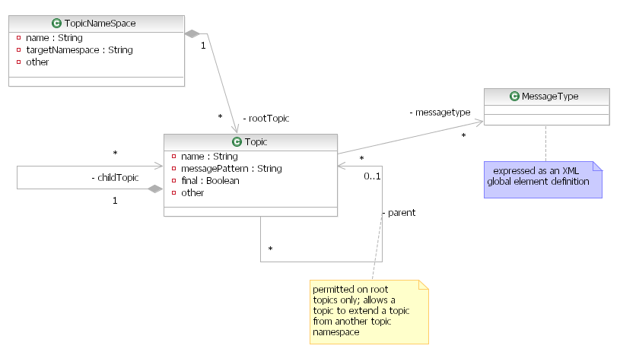
WS-Topics (WS-Notification)
Simple Topic Expression (QName)
e.g. tns:MyTopic
  Path expression with a Namespace
  e.g. tns:/t1/t2/t3
  Path Expression with XPATH wildcarding, .g.
    tns:t1/* all children of t1
    tns:t1//* all descendents of t1
    tns:t1//. t1 + all its descendents

Slide 29
Summary – topics covered in this lecture
Meta-data
Event representation
Event representation in practice in event processing products
Event representation in messaging products and standards

